Slide 1

Academic Session 2025-26
ODD Semester Jul-Dec 2025
UNIVERSITY INSTITUTE OF ENGINEERING
COMPUTER SCIENCE ENGINEERING
Bachelor of Engineering
Semester: 6th
Design and Analysis of Algorithms
(23CSH-301/ITH-301)
Unit No. 1 Chapter No. 2 Lecture No. 11
Topic : Graphs
Richa Dhiman E11307 Assistant Professor

Slide 2
1
Learning Objectives & Outcomes
Objective:
To understand the Graph and types of Graphs.
Outcome:
Student will understand
Graph and its types.

Slide 3
2
Graph
A Graph is a non-linear data structure consisting of nodes and edges. The nodes are sometimes also referred to as vertices and the edges are lines or arcs that connect any two nodes in the graph.
More formally a Graph can be defined as,
A Graph consists of a finite set of vertices(or nodes) and set of Edges which connect a pair of nodes.

Slide 4
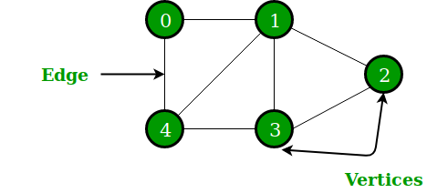
3
In the above Graph, the set of vertices V = {0,1,2,3,4} and the set of edges E = {01, 12, 23, 34, 04, 14, 13}.

Slide 5
4
Graphs are used to solve many real-life problems.
Graphs are used to represent networks. The networks may include paths in a city or telephone network or circuit network.
Graphs are also used in social networks like linkedIn, Facebook. For example, in Facebook, each person is represented with a vertex(or node). Each node is a structure and contains information like person id, name, gender, locale etc.

Slide 6
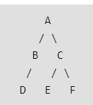
5
DFS
DFS stands for Depth First Search is a edge based technique. It uses the Stack data structure, performs two stages, first visited vertices are pushed into stack and second if there is no vertices then visited vertices are popped. Ex-
Output is: A, B, D, C, E, F

Slide 7
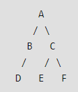
6
BFS
BFS stands for Breadth First Search is a vertex based technique for finding a shortest path in graph. It uses a Queue data structure which follows first in first out. In BFS, one vertex is selected at a time when it is visited and marked then its adjacent are visited and stored in the queue. It is slower than DFS.
Output is:
A, B, C, D, E, F

Slide 8
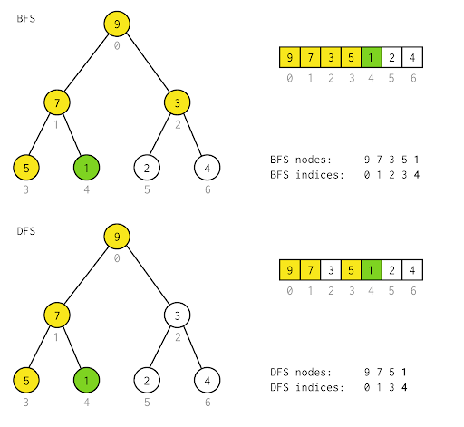
7

Slide 9
Applications
8
Social Networks
Web Page Ranking (e.g., PageRank in search engines)
Computer Networks and Routing
Geographic Information Systems (GIS) / Mapping
Recommendation Engines
Dependency Resolution (e.g., package managers, build systems)
Scheduling and Resource Allocation (e.g., task graphs)

Slide 10
Summary
9
Introduction to Algorithm
Characteristic of algorithm
Needs and specification of algorithm

Slide 11
10
Next Lecture
Sorting in linear time: counting sort

Slide 12
11
Quiz
In a weighted graph with nonnegative weights, which algorithm finds the shortest path from a single source to all other vertices? A) Bellman-Ford B) Dijkstra’s C) Floyd-Warshall D) Kruskal’s
Which of these is a property of a tree when considered as a graph? A) It can contain cycles. B) It has exactly V edges for V vertices. C) It is a connected, acyclic undirected graph with V – 1 edges. D) It is always directed.

Slide 13
12
References/ Articles/ Videos
Text books:
Cormen, Leiserson, Rivest, Stein, “Introduction to Algorithms”, Prentice Hall of India, 3rd edition 2012. problem, Graph coloring.
Horowitz, Sahni and Rajasekaran, “Fundamentals of ComputerAlgorithms”, University Press (India), 2nd edition
Websites:
geeksforgeeks.org/graph-data-structure-and-algorithms/
https://www.geeksforgeeks.org/difference-between-bfs-and-dfs/

Slide 14
13
Faculty-curated videos, NPTEL, Coursera, LinkedIn, or other relevant learning resources
https://onlinecourses.nptel.ac.in/noc23_cs96/preview
https://nptel.ac.in/courses/106106131
https://nptel.ac.in/courses/106106208
https://www.linkedin.com/learning/learning-algorithms

Slide 15
14
Class-Wise Feedback

Slide 16
15
Thank You
For queries
Email: richa.e11307@cumail.in

